Slide 1
CS2005 Database Systems
Fall 2021
National University of Computer and Emerging Sciences

Slide 2
CHAPTER 22
Database Recovery Techniques

Slide 3
Introduction
Recovery algorithms
Recovery concepts
  Write-ahead logging
  In-place versus shadow updates
  Rollback
  Deferred update
  Immediate update
Certain recovery techniques best used with specific concurrency control methods

Slide 4
22.1 Recovery Concepts
Recovery process restores database to most recent consistent state before time of failure
Information kept in system log
Typical recovery strategies
  Restore backed-up copy of database
    Best in cases of extensive damage
  Identify any changes that may cause inconsistency
    Best in cases of noncatastrophic failure
    Some operations may require redo

Slide 5
Recovery Concepts (cont’d.)
Deferred update techniques
  Do not physically update the database until after transaction commits
    all transaction updates are recorded in the local transaction workspace or in the main memory buffers that the DBMS maintains (the DBMS main memory cache)
  Undo is not needed; redo may be needed
Immediate update techniques
  Database may be updated by some operations of a transaction before it reaches commit point
  Operations also recorded in log making recovery still possible
  If a transaction fails after recording some changes in the database on disk but before reaching its commit point, the effect of its operations on the database must be undone ;that is, the transaction must be rolled back.
  In the general case of immediate update, both undo and redo may be required during recovery

Slide 6
Recovery Concepts (cont’d.)
Undo and redo operations required to be idempotent
  Executing operations multiple times equivalent to executing just once
  Entire recovery process should be idempotent
Caching (buffering) of disk blocks
  DBMS cache: a collection of in-memory buffers
  Cache directory keeps track of which database items are in the buffers

Slide 7
Recovery Concepts (cont’d.)
Cache buffers replaced (flushed) to make space for new items
Dirty bit associated with each buffer in the cache
  Indicates whether the buffer has been modified
Contents written back to disk before flush if dirty bit equals one
Pin-unpin bit
  Page is pinned if it cannot be written back to disk yet

Slide 8
Recovery Concepts (cont’d.)
Main strategies
  In-place updating
    Writes the buffer to the same original disk location
    Overwrites old values of any changed data items
  Shadowing
    Writes an updated buffer at a different disk location, to maintain multiple versions of data items
    Not typically used in practice
Before-image: old value of data item
After-image: new value of data item

Slide 9
Recovery Concepts (cont’d.)
Write-ahead logging
  Ensure the before-image (BFIM) is recorded
  Appropriate log entry flushed to disk
  Necessary for UNDO operation if needed
UNDO-type log entries
REDO-type log entries

Slide 10
Recovery Concepts (cont’d.)
Steal/no-steal and force/no-force
  Rules that govern when a page from the database cache can be written to disk
  No-steal approach
    Cache buffer page updated by a transaction cannot be written to disk before the transaction commits
  Steal approach
    Recovery protocol allows writing an updated buffer before the transaction commits

Slide 11
Recovery Concepts (cont’d.)
Force approach
  All pages updated by a transaction are immediately written to disk before the transaction commits
  Otherwise, no-force
Typical database systems employ a steal/no-force strategy
  Advantage of “steal” is that it avoids need for very large buffer space to store all updated pages in memory
  Advantage of “no-force” is that an updated page of a committed transaction may still be in the buffer when another transaction needs to update it, thus eliminating the I/O cost to write that page multiple times to disk and possible having to read it again from disk

Slide 12
Recovery Concepts (cont’d.)
Write-Ahead Logging (WAL) protocol for recovery algorithm requiring both UNDO and REDO
  BFIM of an item cannot be overwritten by its after image until all UNDO-type log entries have been force-written to disk
  Commit operation of a transaction cannot be completed until all REDO-type and UNDO-type log records for that transaction have been force-written to disk

Slide 13
To facilitate the recovery process, the DBMS recovery subsystem may need to
maintain a number of lists related to the transactions being processed in the system.
  These include a list for active transactions that have started but not committed as
  yet, and they may also include lists of all committed and aborted transactions
  since the last checkpoint

Slide 14
Checkpoints in the System Log and Fuzzy Checkpointing
Taking a checkpoint
  Suspend execution of all transactions temporarily
  Force-write all main memory buffers that have been modified to disk
  Write a checkpoint record to the log, and force-write the log to the disk
  Resume executing transactions
DBMS recovery manager decides on checkpoint interval
  It may be measured in time – say, every ‘m’ minutes – or in the number ‘t’ of committed transactions since the last checkpoint

Slide 15
Checkpoints in the System Log and Fuzzy Checkpointing (cont’d.)
Fuzzy checkpointing
  System can resume transaction processing after a begin_checkpoint record is written to the log
  Previous checkpoint record maintained until end_checkpoint record is written

Slide 16
Transaction Rollback
Transaction failure after update but before commit
  Necessary to roll back the transaction
  Old data values restored using undo-type log entries
Cascading rollback
  If transaction T is rolled back, any transaction S that has read value of item written by T, similarly any transaction R that has read value of item written by S, and so on…, must also be rolled back
  possible only when recovery protocol ensures recoverable schedules but does not ensure strict or cascade less schedule
  Almost all recovery mechanisms designed to avoid this

Slide 17
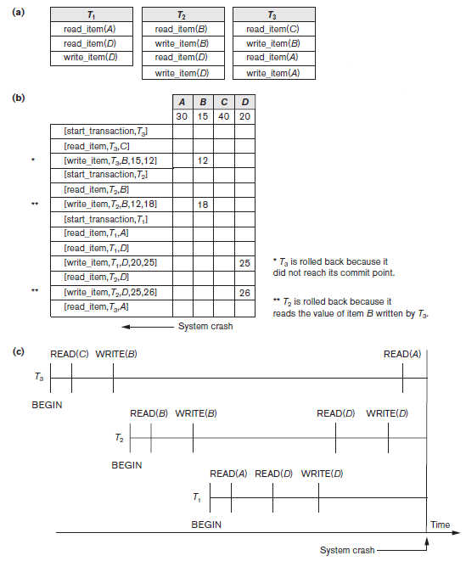
Figure 22.1 Illustrating cascading rollback (a process that never occurs
in strict or cascadeless
schedules) (a) The read and write operations of three transactions (b) System log at point of crash (c) Operations before the crash

Slide 18
Transactions that Do Not Affect the Database
Example actions: generating and printing messages and reports
If transaction fails before completion, may not want user to get these reports
  Reports should be generated only after transaction reaches commit point
Commands that generate reports issued as batch jobs executed only after transaction reaches commit point
  Batch jobs canceled if transaction fails

